Slide 1

By Ava DeBartolomeis

Slide 2
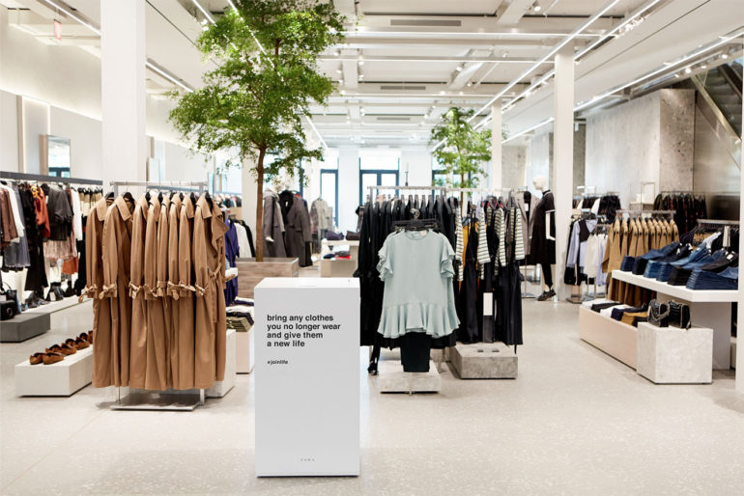
Value Proposition
Zara promises that their “products meet the most stringent health, safety and environmental sustainability standards”
They’re geared towards an eco-friendly production by “carry[ing] out quality controls at every stage of the supply chain to ensure [their] products are good for people and the environment”
They are animal and forest friendly, as well
Their goal: to make their products increasingly more sustainable

Slide 3
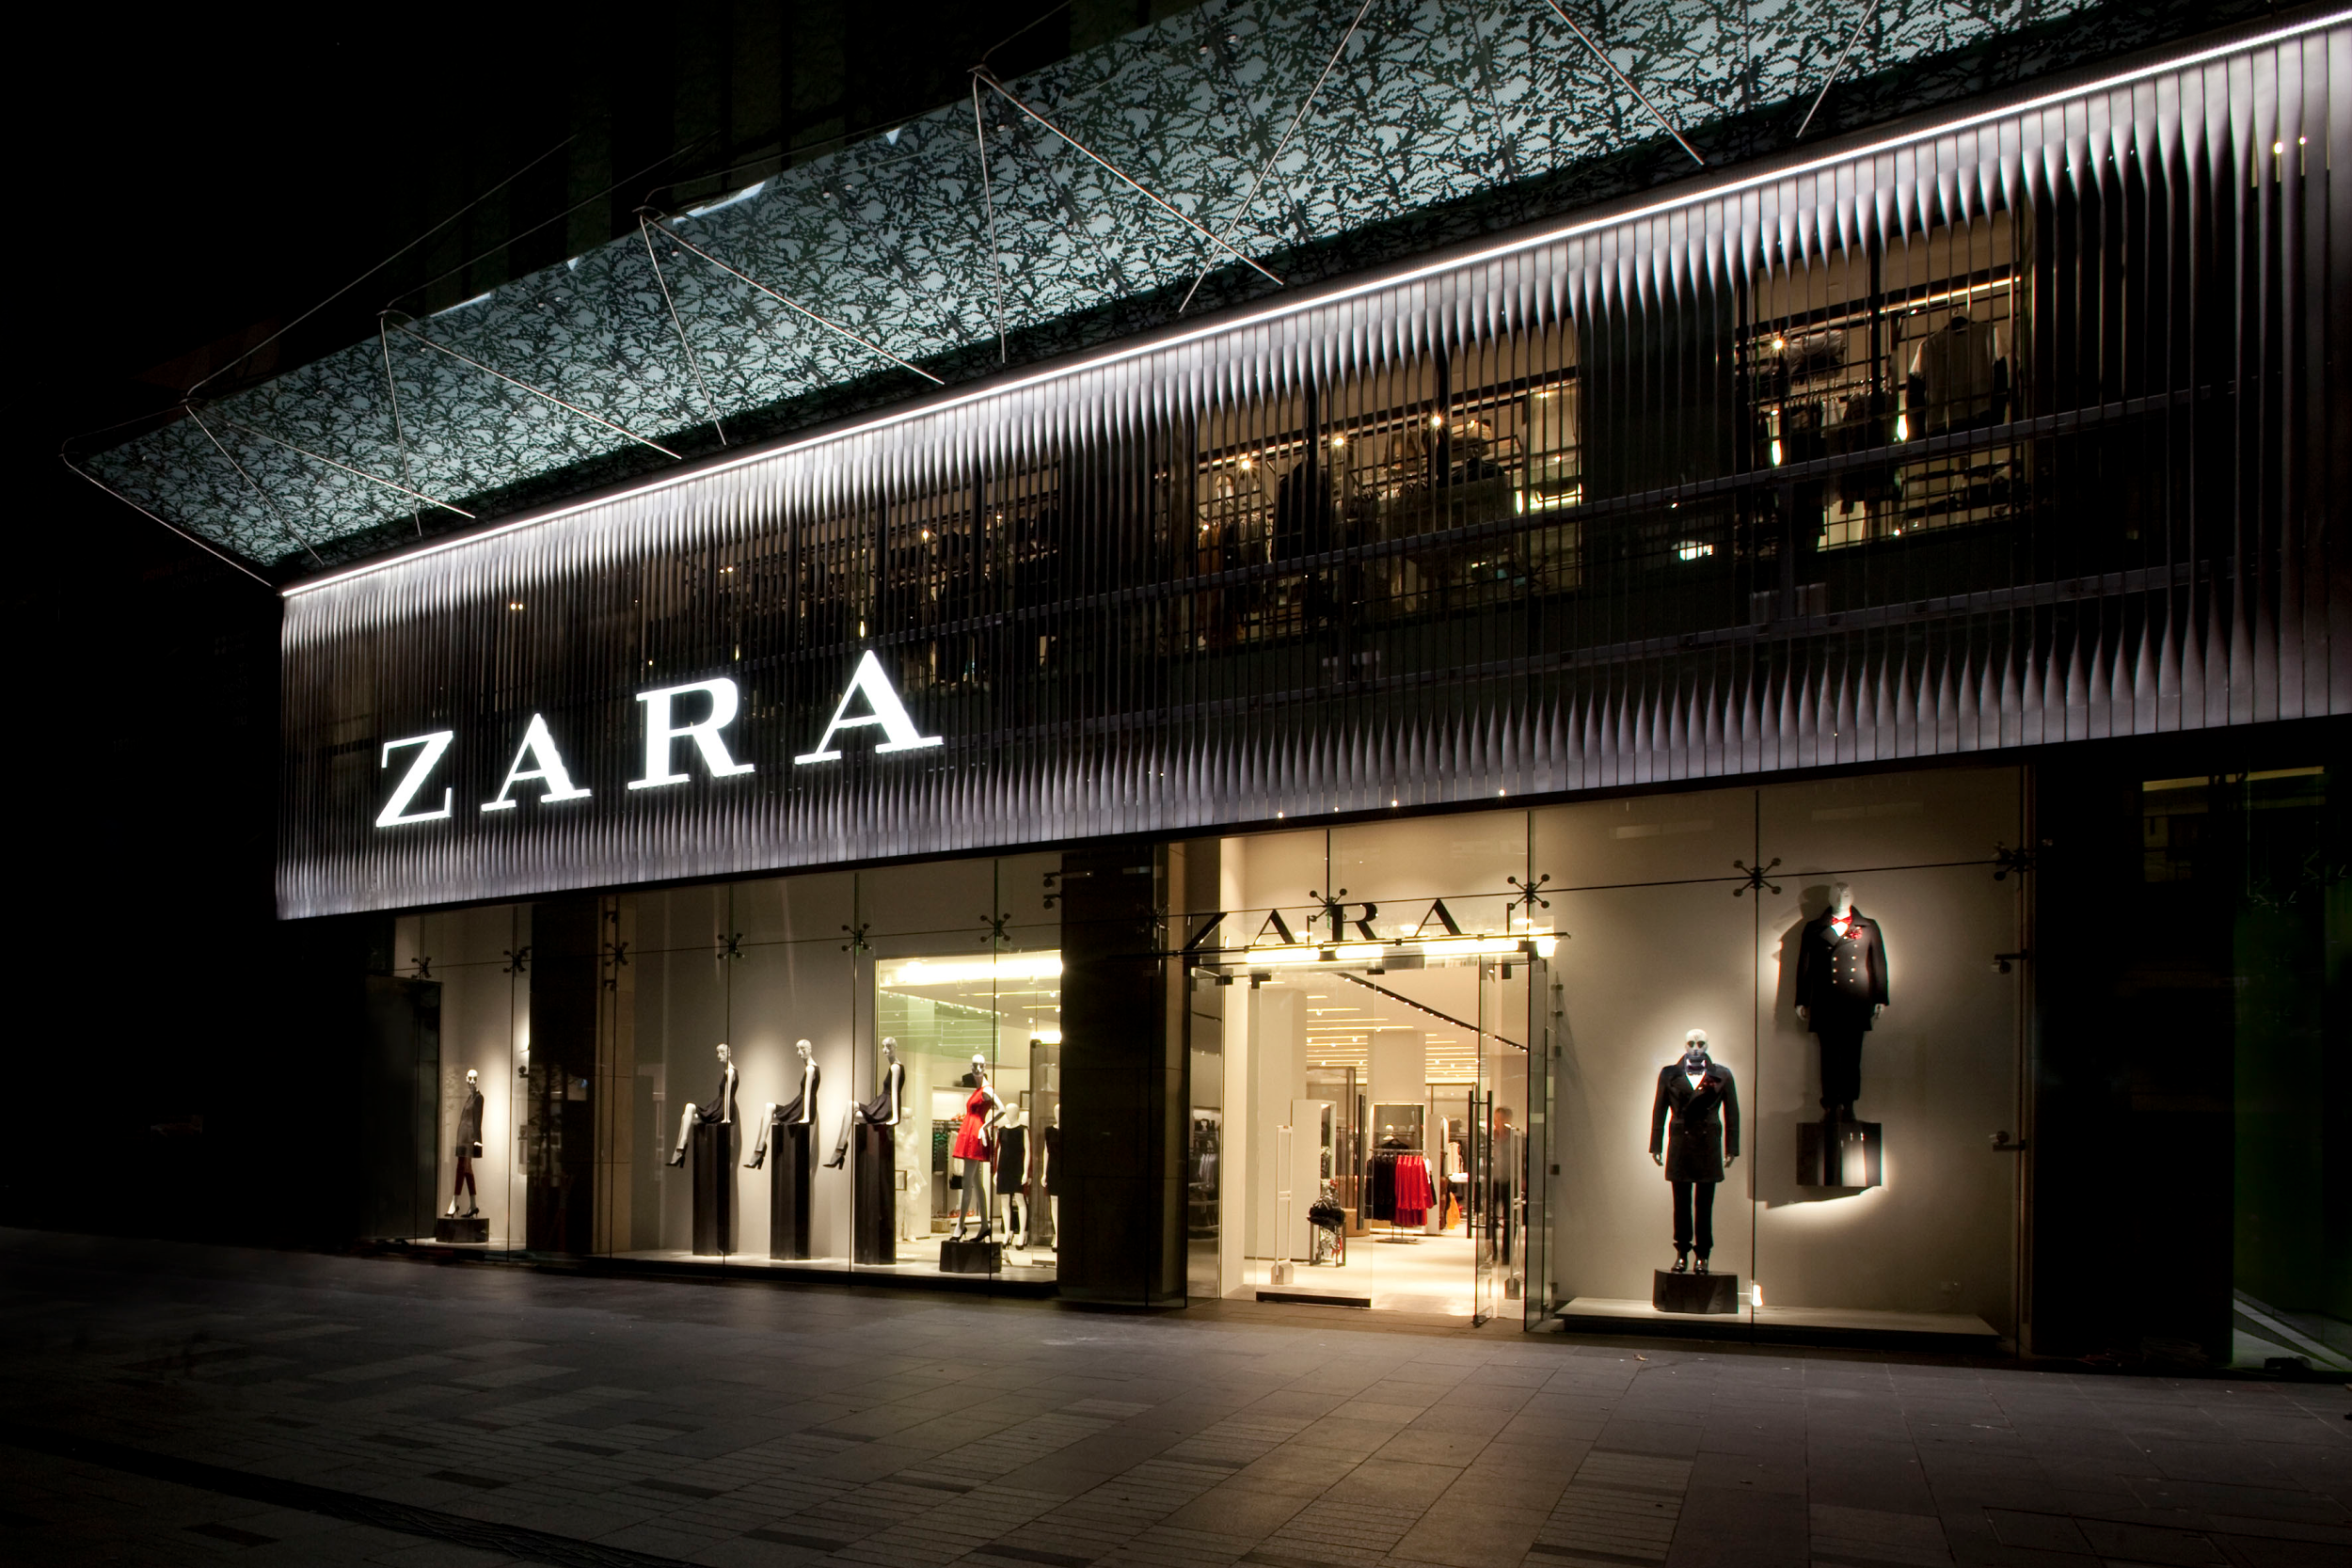
Brand Identity
Zara is known for their modern, innovative, and trendsetting fashion designs, all while maintaining reasonable prices and healthy, eco-friendly production practices

Slide 4
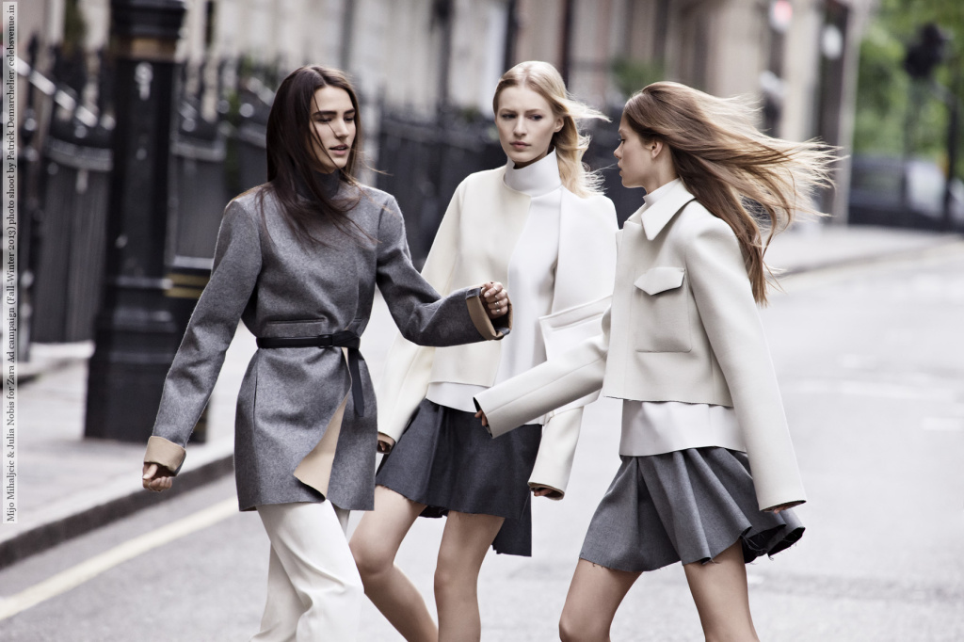
Target Market
Zara targets the fashion-forward professional cosmopolitan who wants the latest trends at a luxury quality for less than luxury prices
Their audience is also made up of people who care about the background behind their clothing
The age group would mainly consist of ages 20-40

Slide 5
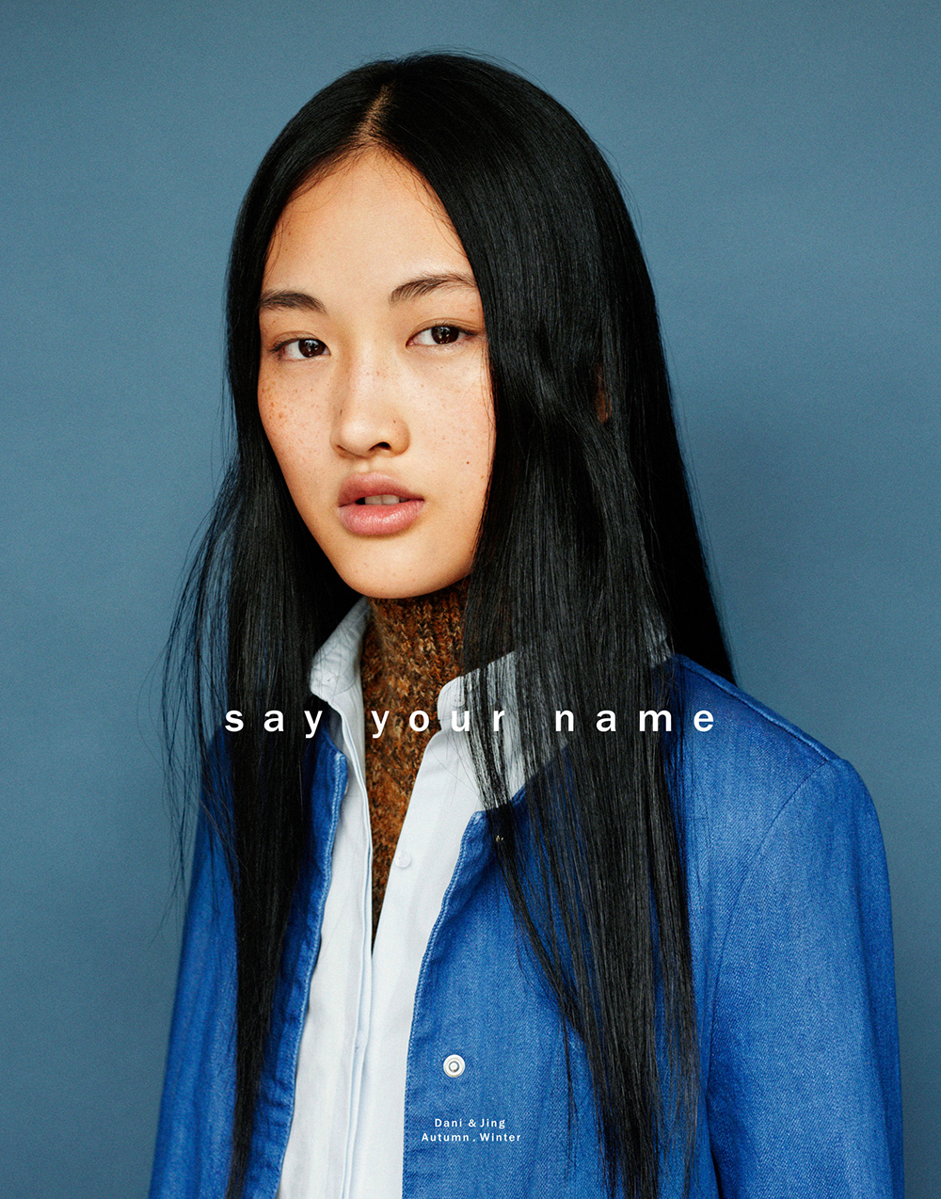
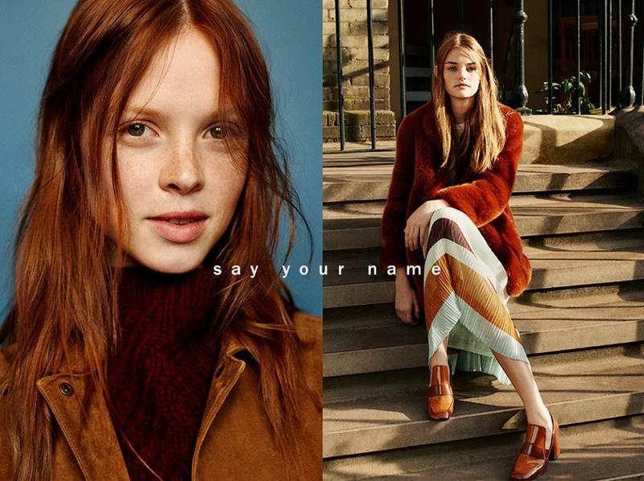
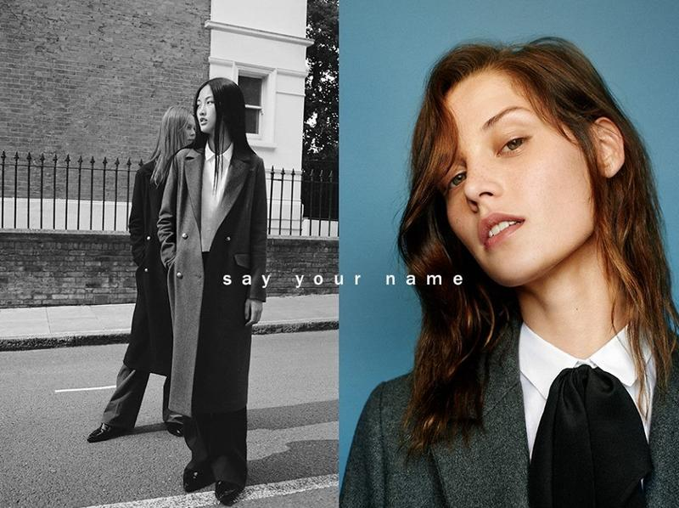
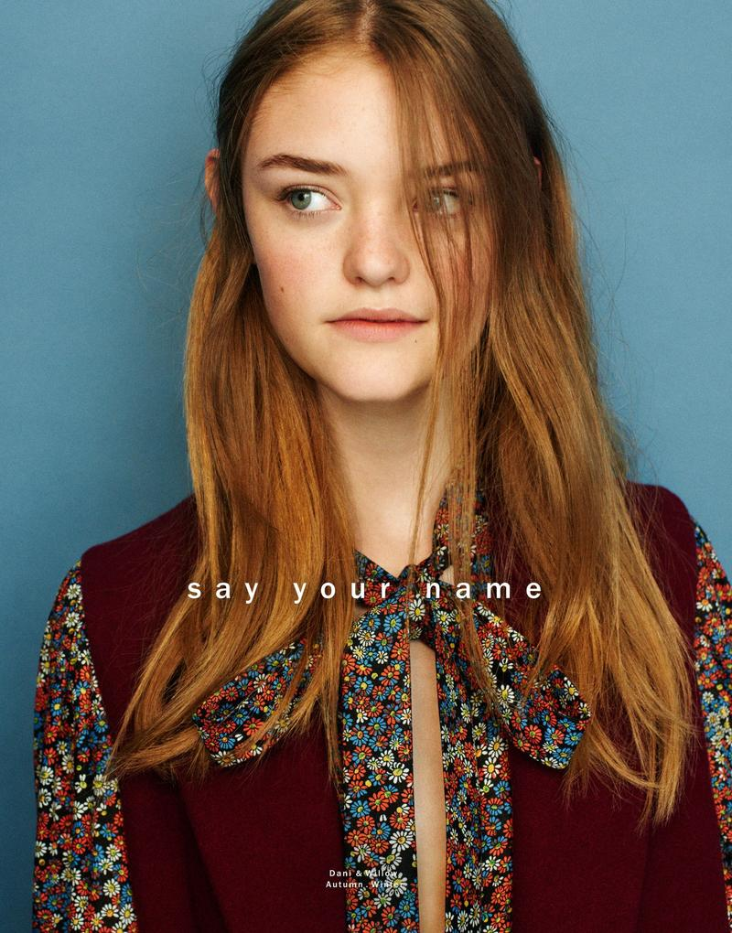
“Say Your Name” Campaign

Slide 6
“Say Your Name” Campaign (Fall/Winter 2015)
This campaign focused on the representation of who you are through the clothes you wear
The simple photographs with the “Say Your Name” text is minimal, yet interesting, which is Zara’s identity and follows consistency
It gets the message across that they want customers to buy their products to show who they are, which resonates with all people purchasing clothing

Slide 7
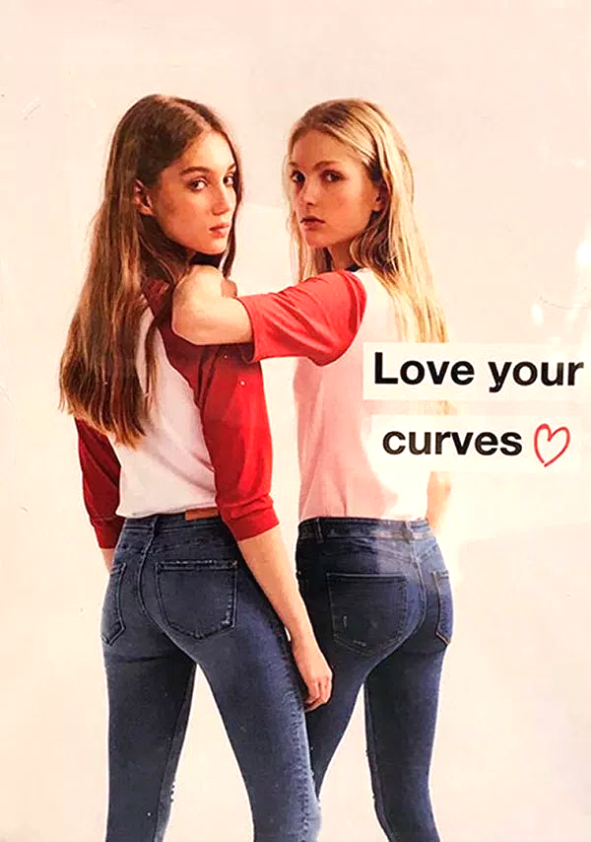
“Love Your Curves” Campaign (Spring 2017)

Slide 8
“Love Your Curves” Campaign (Spring 2017)
Zara tried to appeal to all types of body types with this ad, but failed in the execution
The idea was strategic because it would evolve their target audience to not just people who look like their models
Because both models in the ad were thin and did not have curves, their ad lacked the success that it could have and caused a lot of controversy within Zara customers

Slide 9
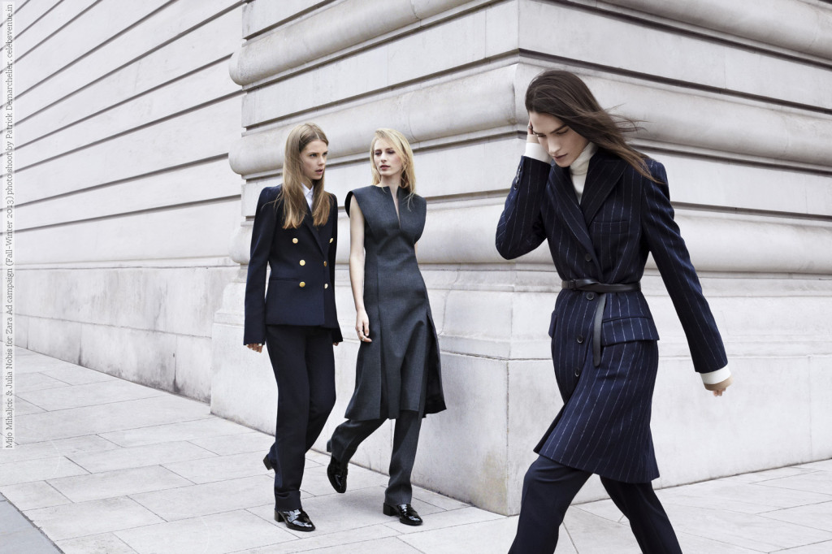
Recommendations
I have always been aware that Zara cares so much about how their products are made, but this is not made evident to all of their audience
In order to strengthen the effect of their brand positioning and to create awareness, I think they should release an ad campaign focusing on how they make their products in terms of being eco-friendly
  This would then extend their target audience to those committed to the environment, as well as reinforce the distinction between Zara and other brands that will sway audiences to choose Zara

Slide 10
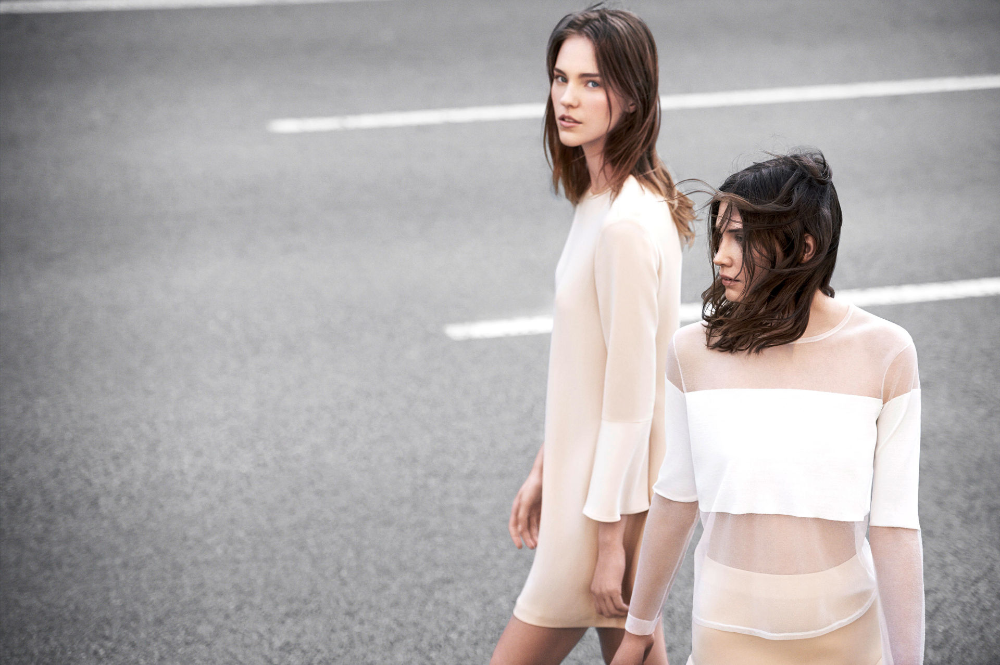
Recommendations
Referring to Zara’s “Love Your Curves” campaign, I would suggest capturing models of all different sizes, not just thin women
This would enforce the message they intended to spread by actually portraying women who have curves
The result would be a greater appreciation for their brand and would make people aware that Zara believes anyone can wear their clothing, which will cause more people to buy it
Zara could promote a hashtag called #LoveYourCurves to show how much they do care about promoting clothing for people of all body types

Slide 11
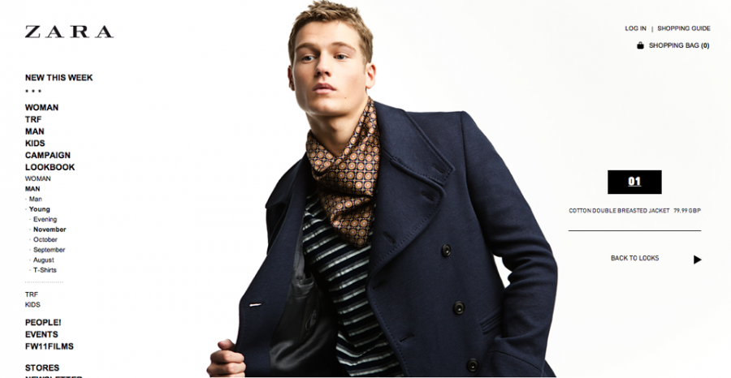
KPIs
Check the trend in website views
Track the number of likes on Instagram posts regarding the re-done “Love Your Curves” campaign
Track the use of #LoveYourCurves after Zara posts their first post with it for the improved campaign
Track the amount of time people spend on the site per visit
Calculate the new conversion rate every month after the campaign is released

